Slide 1


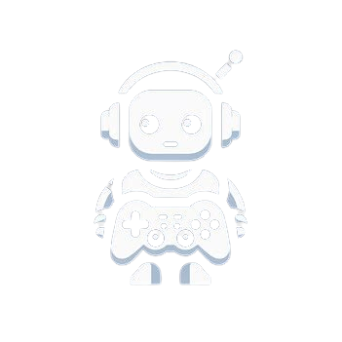
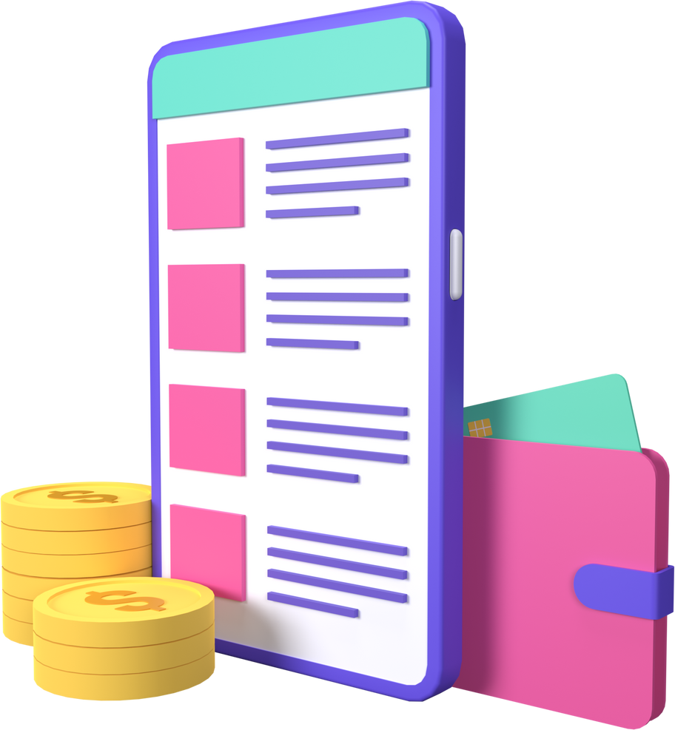


BOTIFY
Streamlined merchandise monitization platform integrated within Discord for gamers

Slide 2
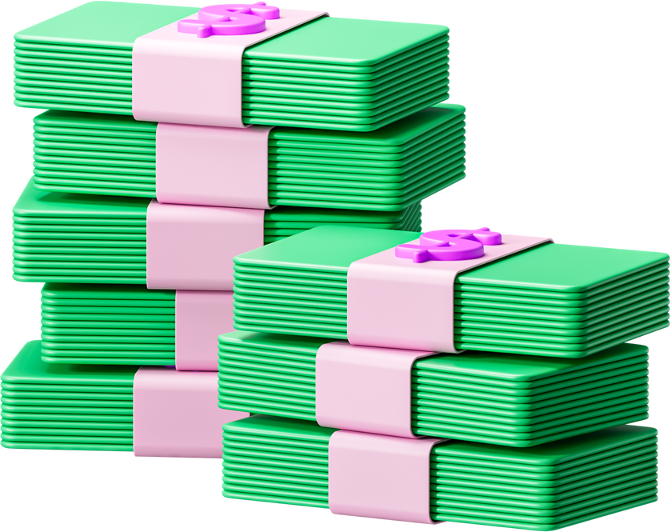

BOTIFY
Problem Statement
Gamers encounter challenges with pricey website setups for merchandise sales. Navigating expensive website setups poses barriers for gamers seeking to monetize their brand. Technical complexities deter entrepreneurial pursuits, leaving gaming's economic potential untapped.

Slide 3
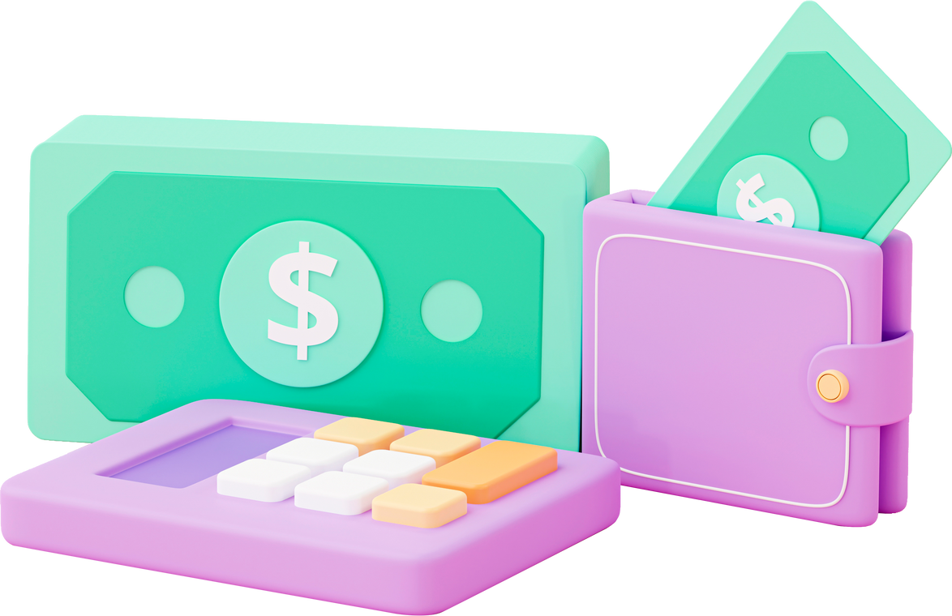
BOTIFY
Solution
"Our innovative Discord bot transforms the merchandise sales landscape for gamers. With seamless product showcases, effortless transactions, and insightful analytics, we empower gamers to thrive, all while saving precious time and resources."

Slide 4




BOTIFY
Uses & Benefits
SECURITY OF BLOCKCHAIN
PAYMENT USING FAT
BEGINNER FRIENDLY

Slide 5
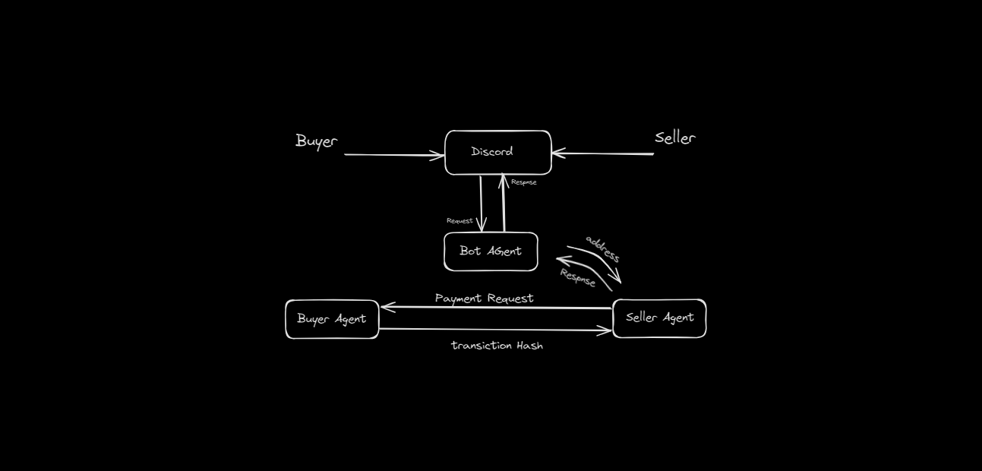
BOTIFY
BOTIFY
Block Diagram

